Slide 1
The benefits
of more
Delta Dental of Colorado + TBD
Month XX, 2024

Slide 2
Our network
DeltaVision®
Plan enhancements
Importance of good oral health
Today’s
discussion
Using your benefits

Slide 3

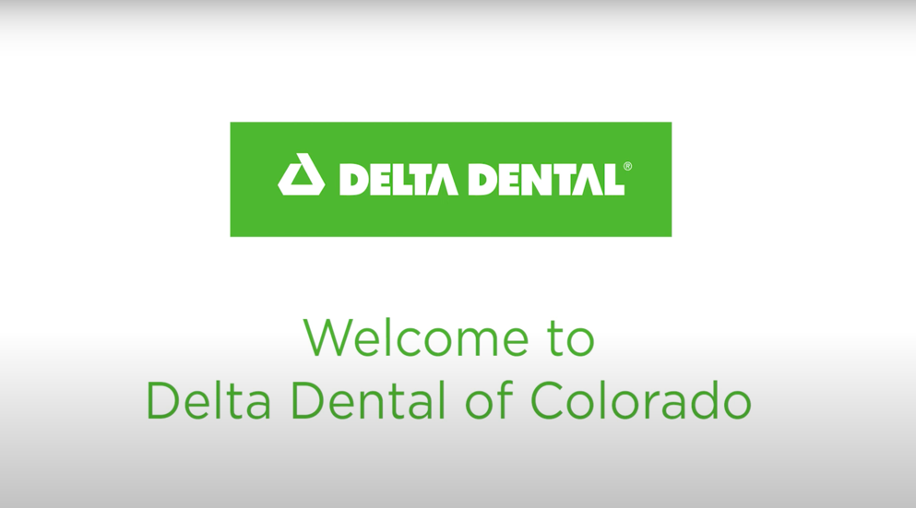
Notes:
Click on image in Slideshow to play video

Slide 4

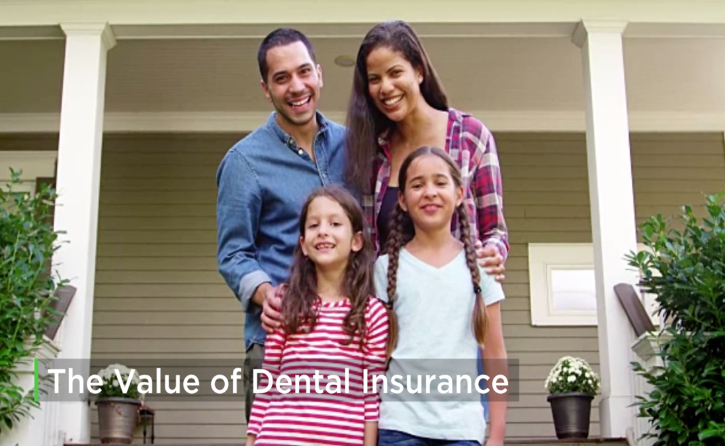


Notes:
Click on image in Slideshow to play video
https://www.youtube.com/watch?v=8IQ2j5GMn2A&feature=youtu.be

Slide 5


More choices for
oral health care
Our network

Slide 6
Two networks working together
Which Delta Dental network is your dentist contracted with?
We have more than 3,700 Premier® providers and more than 2,600 PPO™ providers
in Colorado.
Premier®
PPO™
More than 91% of all Colorado dentists are in our network, and
3 out of 4 dentists nationwide participate with us.
Notes:
About 91% of CO dentists are in one of our two networks, that is more than 7000 access points across the state. As I mentioned earlier, you will achieve maximum savings by seeing a PPO provider. We have more than 155,000 dentists nationwide. That means 3 out of 4 dentists participate in the Delta Dental network.

Slide 7
Advantages of Dental Dental’s network
PPO™ Provider
Premier® Provider
Non-Participating Provider
Best out-of-pocket costs savings due to discount
Balance-billing protection
No out-of-pocket costs savings due to discount
No balance-billing protection
Lower out-of-pocket costs savings because of network discount
Balance-billing protection
Notes:
Delta Dental’s dual PPO and Premier network offers discounts off the cost of treatment and protection against balance-billing. There is no difference in quality between these two networks – only fee structures. A PPO provider will always save you the most in out-of-pocket costs. You will also save by seeing a Delta Dental Premier provider, but not as much as with a PPO provider. Non-participating providers have not agreed to any discounts with Delta Dental so you may be responsible for the entire difference between what the plan covers and what your provider has billed.

Slide 8
Best value for members
Using network dentists helps you save on out-of-pocket costs
Example procedure: Porcelain crown
 | Delta Dental PPO™ | Delta Dental Premier® | Non-Participating
Average Submitted Charge | $1,460 | $1,460 | $1,460
DDCO Contracted Allowance | $890 | $1,160 | $860*
Member Coinsurance | 50% | 50% | 50%
Total Member Cost (Balance Billed + Co-Share) | $445 | $580 | $1030 ($860*50%=$430 + $600 in balance billing)
*No contract exists for non-participating providers. Non-participating allowed amount represents DDCO’s average allowed across multiple non-participating reimbursement arrangements.
Notes:
We have included an example to show you the differences between the three networks. As you can see on the bottom line, your cost increases significantly by going out of network, but you can save even more by getting services from a PPO provider.

Slide 9


Doing more
for vision care
DeltaVision®

Slide 10



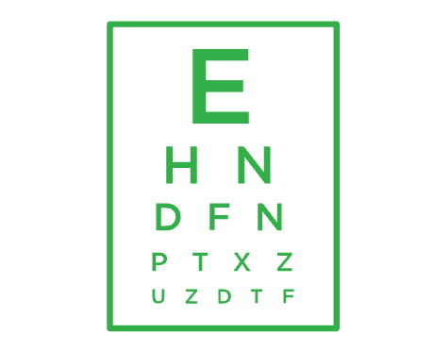

DeltaVision® overview
Industry-leading vision benefits
Extensive provider network
Focus on routine preventive care
Helpful member support
Notes:
Do these key features seem familiar? With DeltaVision, your employees can count on similar benefits to our dental offerings – local choice, nationwide access to care and customer service support if they have any questions. DeltaVision also provides cost saving through a large network of vision care providers.
Our focus on preventive care extends to DeltaVision, because we know that signs of serious health problems can be caught during a routine exam. We encourage routine vision checkups and preventive care as a way to promote good eye health and overall health.

Slide 11



Adding value to your benefits
DeltaVision® in partnership with VSP®
Delta Dental of Colorado and VSP Vision Care are partnering to bring best-in-class vision benefits to complement our dental benefits. That means flexible, quality benefits you can sink your teeth into.
Member savings and seamless service with best-in-class dental and vision benefits.
Provider choices with access to the VSP network of
more than 84,000 access points.
Quality vision care with a comprehensive
WellVision Exam® included.

Slide 12


More ways to address diverse oral health care needs
Plan enhancements

Slide 13

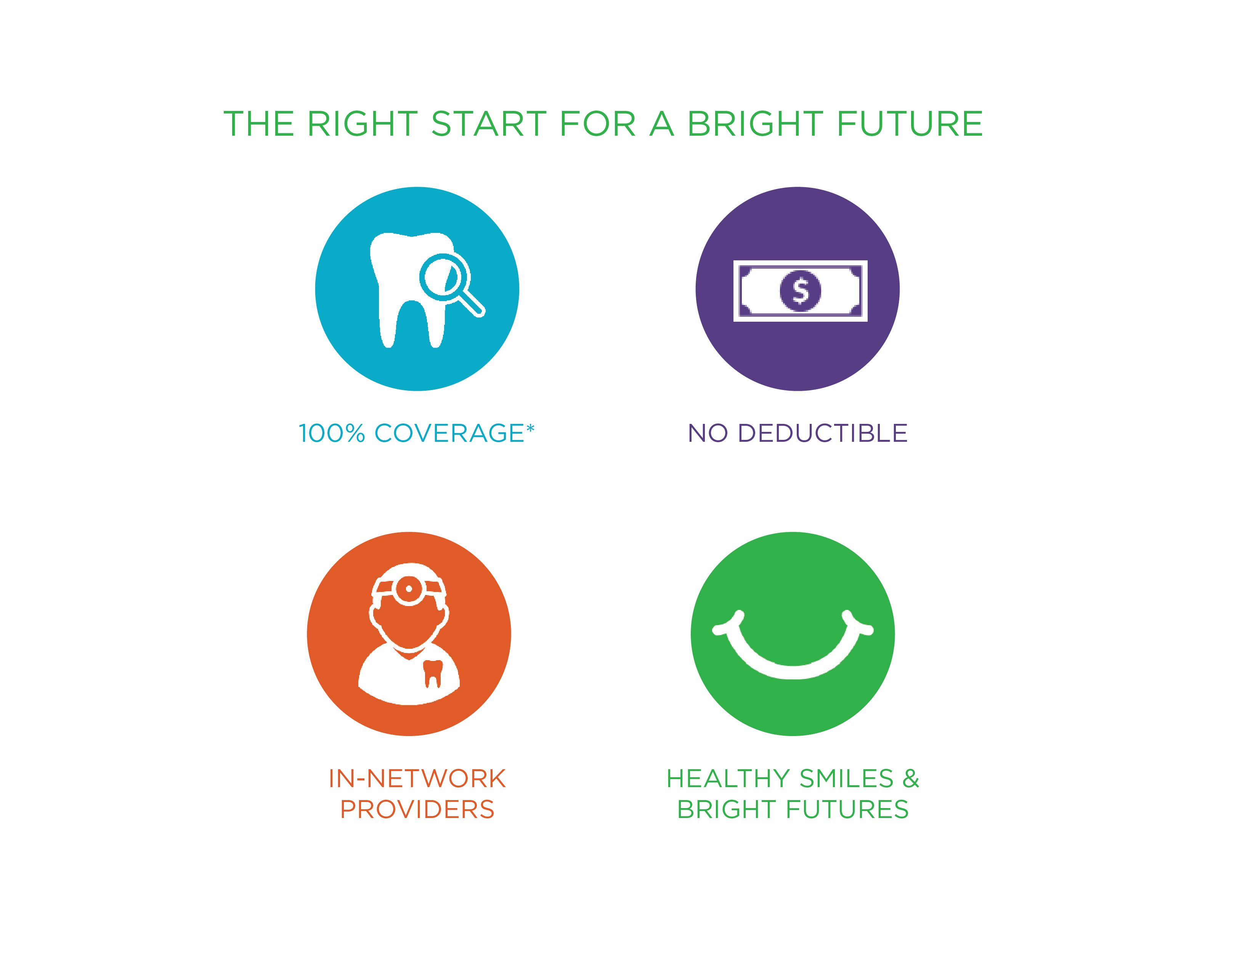
Right Start 4 Kids®
A unique plan design enhancement that removes most of the cost barriers to dental care by providing coverage for children up to their 13th birthday.
Notes:
Right Start 4 Kids removes most of the cost barriers for children 12 and younger when you receive services from a PPO or Premier provider. All services except for orthodontia will be covered at 100% up to the dental plan’s annual or plan year maximum. The deductible is waived as well. Annual maximums, frequency limits, age limits and plan provisions will still apply. The standard deductible and plan percentages will apply for orthodontia or services rendered by a non-participating provider.
RS4K at 100% coinsurance for diagnostic & preventive, basic, and major services, with no deductible, when an in-network provider is seen

Slide 14
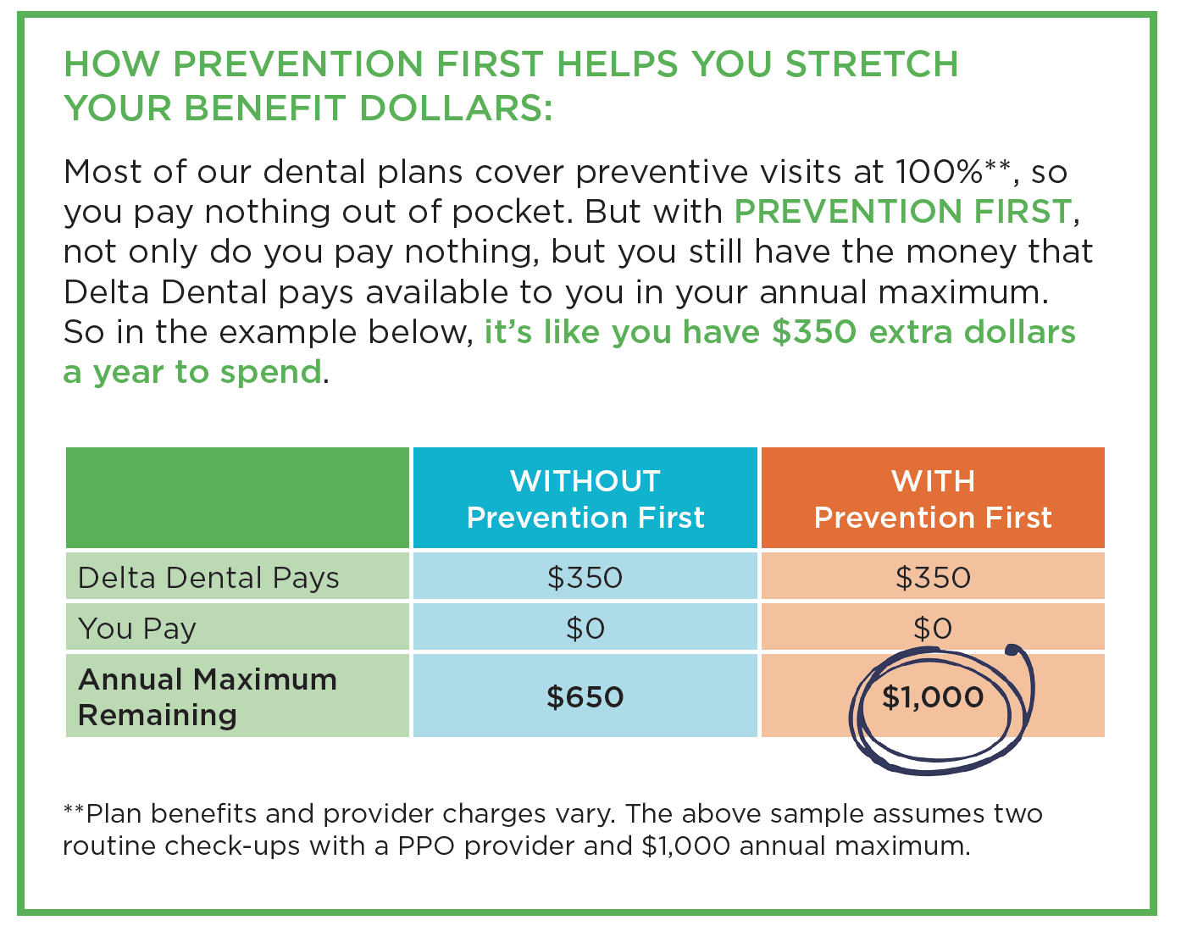
Prevention First
Regular visits to the dentist can improve your oral health and your overall health. Diagnostic and preventive visits will not count against your annual maximum with our Prevention First program. This helps your benefits go further by extending your annual maximum dollars.
Notes:
EFFECTIVE IMMEDIATELY There are no waiting periods. You can start saving money the first day your plan is effective.
EASY TO UNDERSTAND & USE There are no complicated rules to follow or rollover equations to figure out. See your Delta Dental provider* for exams, X-rays, and cleanings, and you will not use any of your annual maximum, so it will be there for any additional treatments you may need in a benefit year. A Delta Dental PPO℠ provider is always your best value!
ENCOURAGES GOOD ORAL HEALTH Unlike other carriers’ max rollover plans, which reward members who don’t use their benefits in order to roll money over into the following benefit year, PREVENTION FIRST encourages you to get your preventive care by not counting these visits against your annual maximum. Not only will your dental benefits go farther, but good preventive care can help you avoid potentially painful and costly restorative treatments down the road.
Delta Dental PPO providers are your best value because you will get a bigger discount (making your annual max go even further) and pay less out of pocket.

Slide 15


Healthcare Spending Card
The Healthcare Spending Card, is a care card that turns dental, vision, and hearing specialist expenses into interest-free payment plans up to $10,000.
Interest-free when repaid over 12 months
Credit line up to $10,000
No annual fees
Repay using pre-tax dollars by linking your HSA to the card

Slide 16
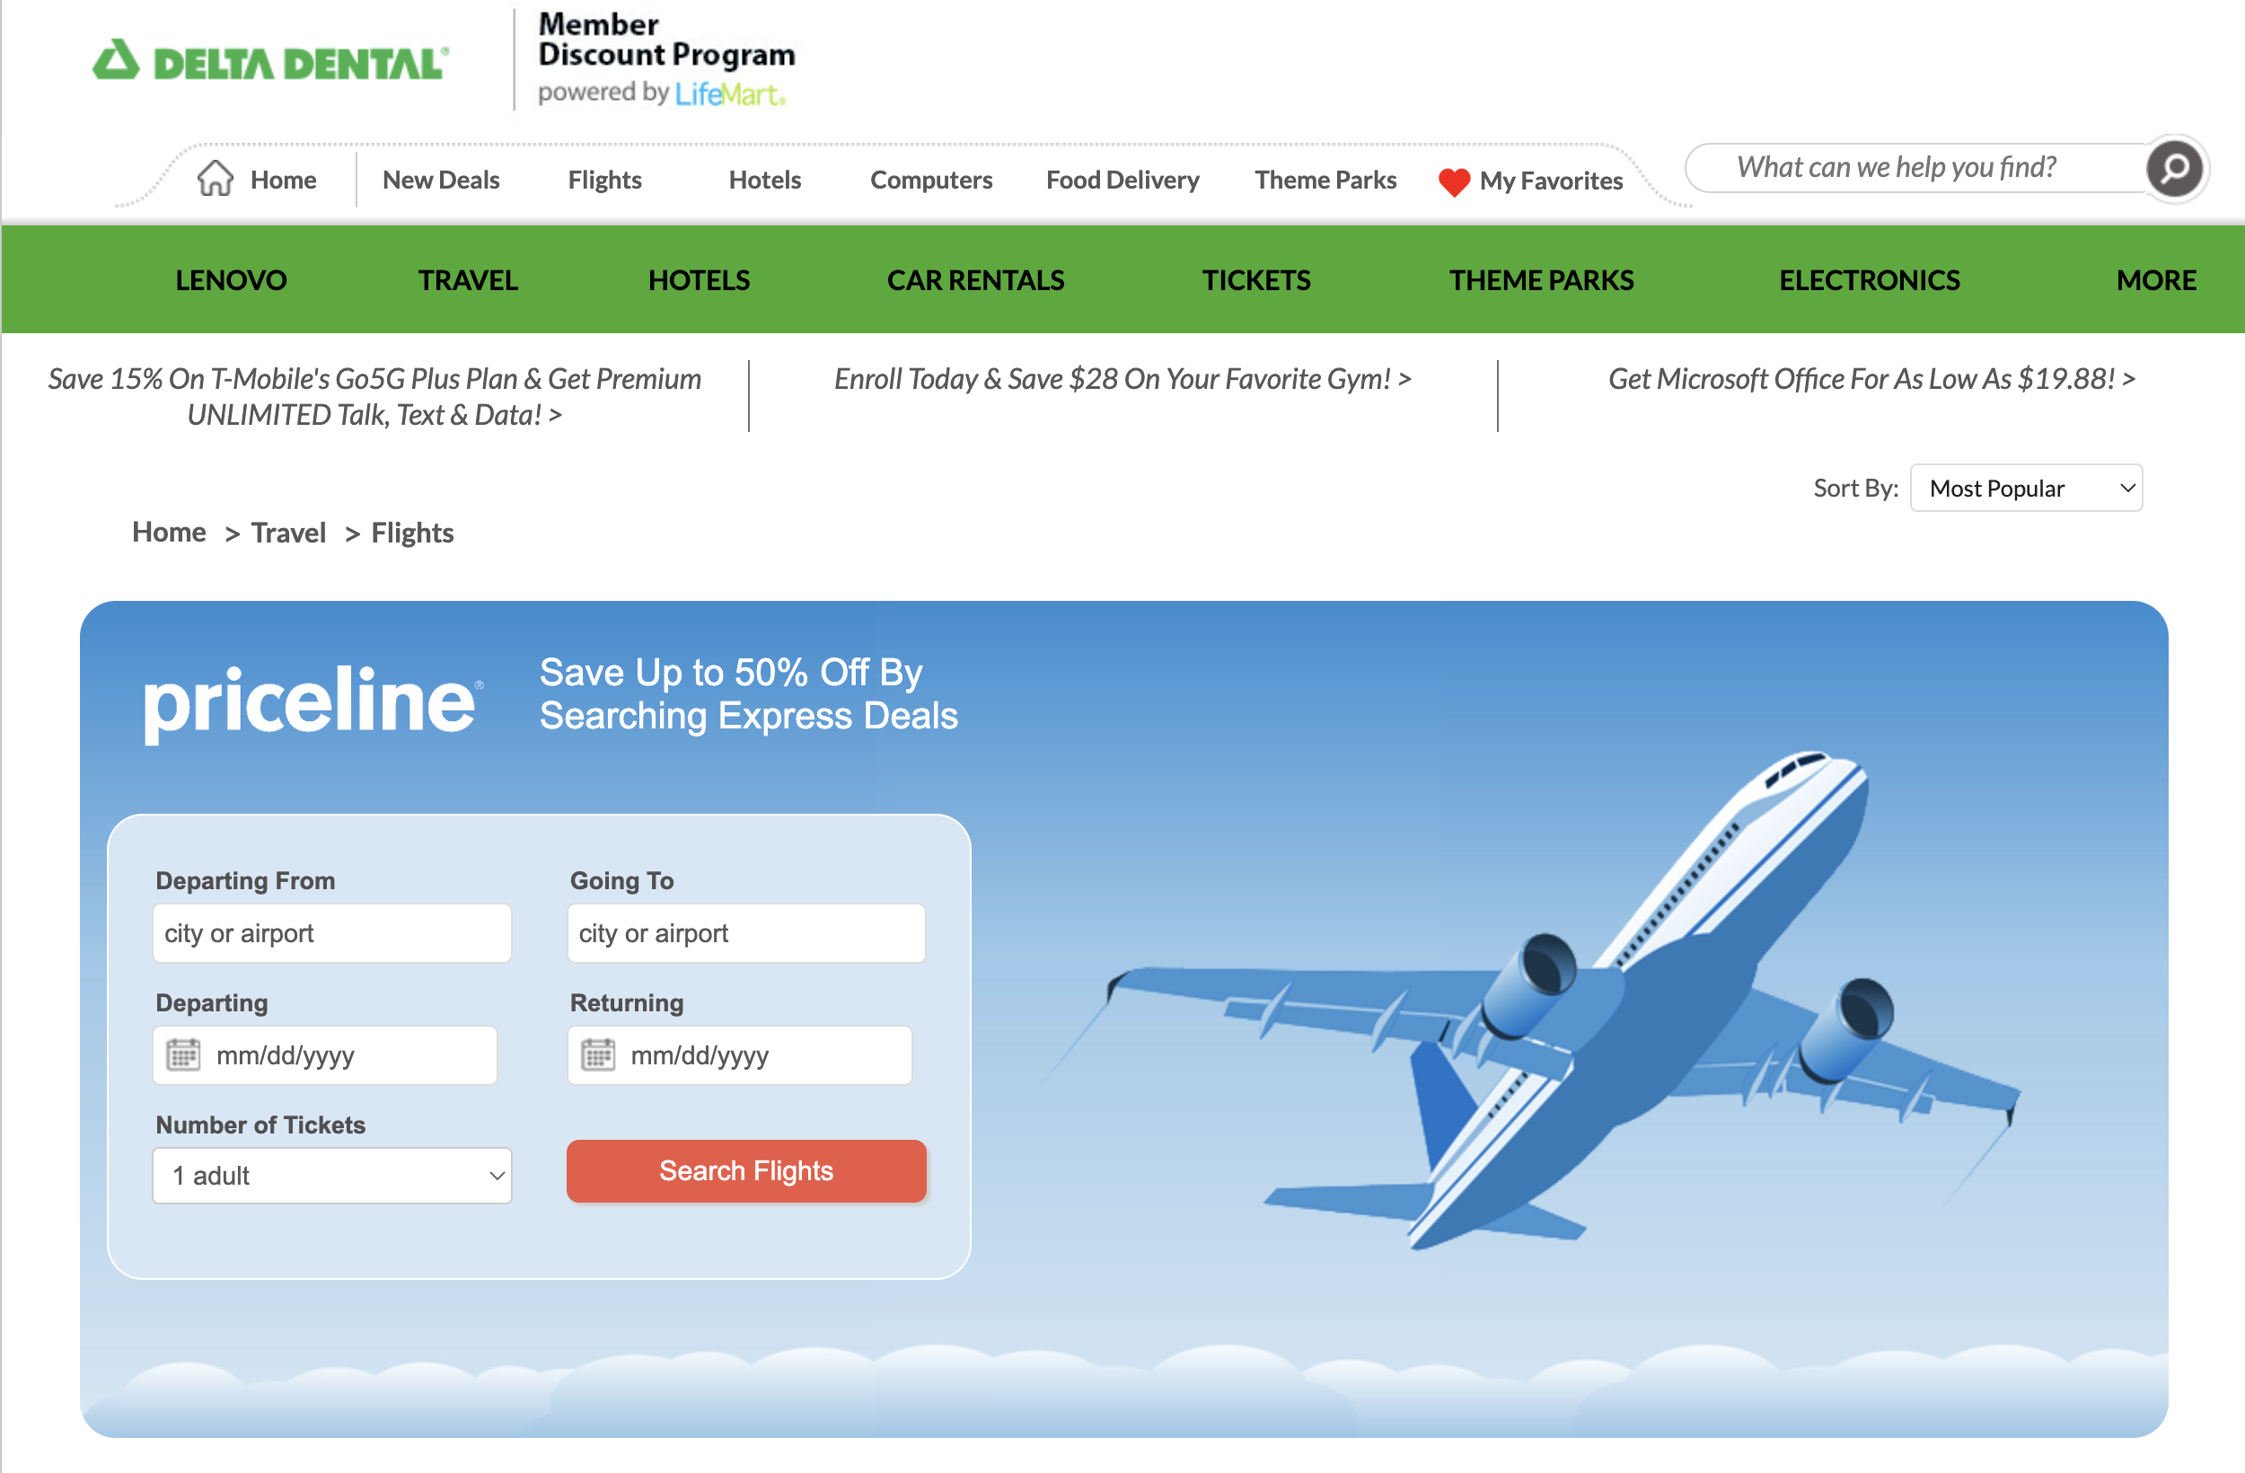
LifeMart
LifeMart is a membership discount program that provides savings on everyday items, travel, entertainment, and more. Every Delta Dental of Colorado member can easily sign up through a special link available after you log into our secure member portal at no cost and start reaping the benefits of savings on hundreds of items.
Notes:
EFFECTIVE IMMEDIATELY There are no waiting periods. You can start saving money the first day your plan is effective.
EASY TO UNDERSTAND & USE There are no complicated rules to follow or rollover equations to figure out. See your Delta Dental provider* for exams, X-rays, and cleanings, and you will not use any of your annual maximum, so it will be there for any additional treatments you may need in a benefit year. A Delta Dental PPO℠ provider is always your best value!
ENCOURAGES GOOD ORAL HEALTH Unlike other carriers’ max rollover plans, which reward members who don’t use their benefits in order to roll money over into the following benefit year, PREVENTION FIRST encourages you to get your preventive care by not counting these visits against your annual maximum. Not only will your dental benefits go farther, but good preventive care can help you avoid potentially painful and costly restorative treatments down the road.
Delta Dental PPO providers are your best value because you will get a bigger discount (making your annual max go even further) and pay less out of pocket.

Slide 17
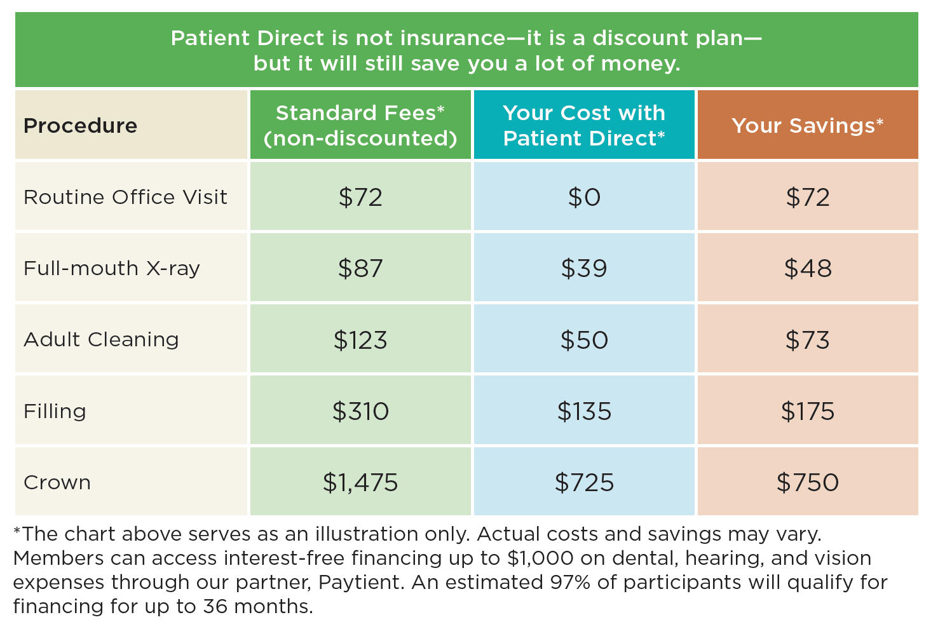
Delta Dental Patient Direct®
Patient Direct is a dental savings plan that provides members with significant savings on certain dental procedures
No maximums
No waiting periods
No annual deductible
No claims to file
Payment is from the patient directly to the provider
Notes:
Delta Dental Patient Direct is a dental plan for groups. Patient Direct is not an insurance plan. It is a dental savings plan that provides members significant savings on certain dental procedures. With Patient Direct, you have no maximums, no waiting periods, no annual deductible, and no claims to file. Payment is from the patient directly to the provider.
With Patient Direct, you can select a dentist from the growing 500-provider Patient Direct network. To find a Patient Direct dentist or to see if your current dentist is in the network, visit DeltaDentalCO.com/ dentist-search.html and select Delta Dental Patient Direct in the Plan dropdown menu. You can also contact our customer service department, Monday–Friday, 7:30 a.m. to 5 p.m. Mountain Time, by calling 1-800-610-0201 (toll-free) or emailing us at customer_service@ddpco.com. All Patient Direct members automatically have access to savings on vision and hearing services and products through partnerships with VSP Savings Pass and Amplifon — both of which have industry-leading networks and discounts. Additionally, a prescription savings card is available through GlicRX, and teledentistry is available through Teledentistry.com.

Slide 18
Delta Dental Patient Direct®
Additional services for Patient Direct® members
VSP Vision Saving Pass
DeltaHearing
Healthcare Spending Card
Virtual Visits
Prescription Discounts
  Savings on hearing aids, tests, and other hearing care-related products and services.
  Access to a national network of hearing professionals.
  Virtual visits
Save you up to 25% on frames
Additional discounts on exams, lenses, contact lenses, and other vision care services!
Easy access to national vision care providers at leading optical retailers.
Learn more at getvspsavings.com
Healthcare Spending Card, is a care card that turns dental, vision, and hearing specialist expenses into interest-free payment plans up to $10,000.
Spread payments over a few weeks or up to 12 months.
Learn more at hsc.lanehealth.com/ddco
The AlphaRx Prescription Discount Program saves you money each time you fill your prescriptions.
You can save up to $95 on the cost of your medication, depending on the medication and the pharmacy.
Learn more at alphadentalplan.com/dental-plans/
Delta Dental Virtual Visits delivered by TeleDentistry.com
Provides 24/7 access to a dentist, 365 days a year.
The fee is $50 and is due at the time of service. It's a safe and effective way to receive care and avoid the emergency room.
Learn more at teledentistry.com/patient-direct/
Notes:
Vision discounts through the VSP Vision Savings Pass™
The Amplifon hearing discount allows you to savings on on hearing aids, tests, and other hearing care-related products and services

Slide 19


Making connections between your oral health and overall health
Importance of
good oral health

Slide 20


Oral health is connected to overall health
The mouth can serve as an important early-warning detection system
Notes:
Oral health is connected to overall health. More than of all systemic diseases are linked to oral health. Poor oral health can lead to and escalate serious overall health issues. The mouth can serve as an important early-warning detection system for more than diseases and dentists and dental hygienists are powerful allies for your overall health and well-being.
Click on image in Slideshow to play video

Slide 21




Oral health facts
Prevention keeps your smile bright and your body healthy.
One out of every two American adults age 30 or older has periodontal disease.
The mouth can provide important early-warning detection for more than 120 diseases.
Tooth decay is the single most common chronic childhood disease.
More than half of U.S. children ages 5 to 9 have at least one cavity or filling.
21
Notes:
More than 120 diseases can cause specific signs and symptoms in and around the mouth and jaw, like swollen or bleeding gums, ulcers, dry mouth, bad breath, and metallic taste. But a dentist doing regular check-ups can spot signs of nutritional deficiencies, general infection, or even symptoms that indicate serious health problems elsewhere in the body. Routine exams allow your dentist to get to know you and follow your health history. Dentists are more able to catch and treat potential problems early when they see their patients on a routine basis.

Slide 22

Healthy living
Healthy habits lead to healthy smiles
What does “healthy living” really mean? Nutritional food, exercise, and plenty of rest are major components of a healthy lifestyle, but other health habits include:
  Regular dentist visits
  Brushing and flossing at least twice a day
  Making food choices that are not just good for your body but good for your teeth
  Sharing your medical conditions with your dentist
22
Notes:
What does “healthy living” really mean? Nutritional food, exercise, and plenty of rest are major components of a healthy lifestyle, but other health habits include:
Regular dentist visits
Brushing and flossing at least twice a day
Making nutritious food choices
Sharing your medical conditions with your dentist
Healthy living includes eating nutritious food, exercise and plenty of rest. Some other healthy habits include regular dentist visits and flossing. Good preventive care can help you avoid potentially painful and costly restorative treatments down the road.

Slide 23


Creating healthy smiles one dentist visit at a time
Using your benefits

Slide 24

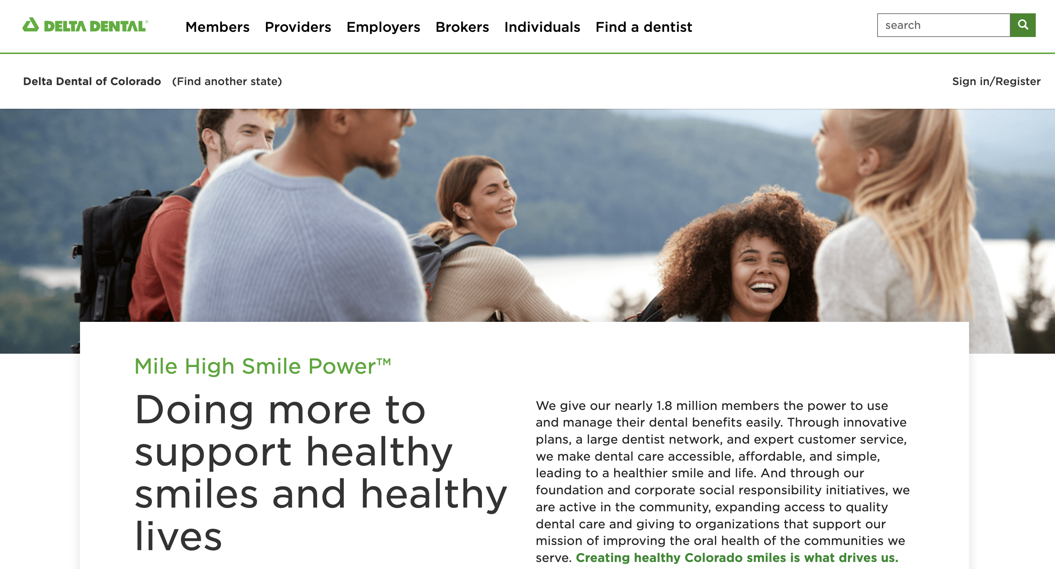
All the information you need
Online tools are available 24/7 at www.deltadentalco.com
Find a dental care provider (with a targeted search of PPO providers for the deepest discount)
Oral health and wellness information
Benefit and claim updates
Notes:
We have many dental tools and lots of information on our website that can help you navigate your dental benefits and understand why a healthy mouth is important to your overall health. That website is www.deltadentalco.com.

Slide 25
How to find a dentist
Three easy ways to find a dentist
The Find a Dentist search tool at www.deltadentalco.com
Our free mobile app, available on iPhone and Android
Our customer service team at
customer_experience@ddpco.com or 1-800-610-0201
Notes:
So you might be wondering how you find a PPO dentist…we have three ways to help you find a dentist near you. Our website, our mobile app, or by calling our customer service team.

Slide 26
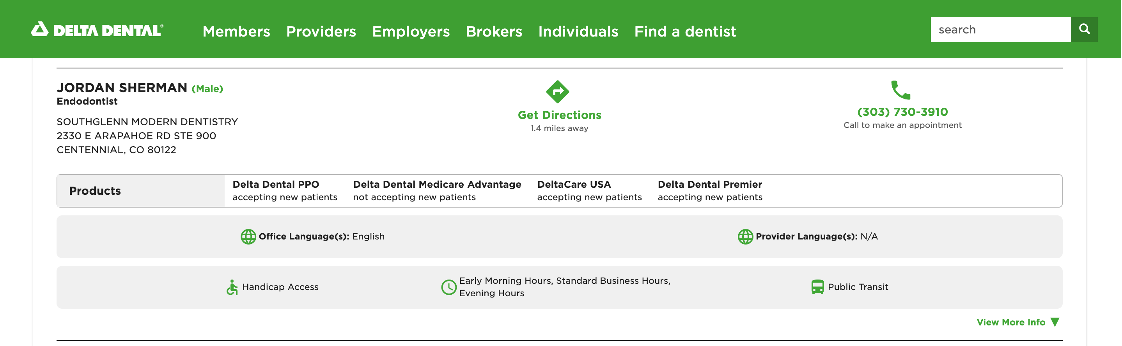
When you find a dentist
Which Delta Dental network is your dentist contracted with?
Notes:
If you go to the website or the mobile app for support, you will see a display similar to the one shown here. If a provider accepts Premier only, you will see Delta Dental Premier listed, but not PPO. If you see both Delta Dental PPO and Premier listed, then the dentist agrees to bill you only up to their PPO fee schedule.

Slide 27

Create a subscriber account
Know what your benefits are to use them wisely
Check your benefits 24 hours a day, seven days a week
Print your member ID cards
Check the status of a claim and view the Explanation of Benefits
View your plan details and print a full Benefit Report
Get an idea of procedure costs with our Cost Estimator tool
Access your benefit information on the mobile app
Notes:
Creating a subscriber account can help you more easily manage your dental benefits. You will be able to check your benefits at any time, not just during normal business hours. While ID cards are not required, members can print an ID card, view their Explanation of Benefit (EOB) statement, or use our cost estimator tool that shows the average cost of certain services. We highly recommend that your dentist request a pre-determination of benefit for services that are expected to cost $400 or more.

Slide 28
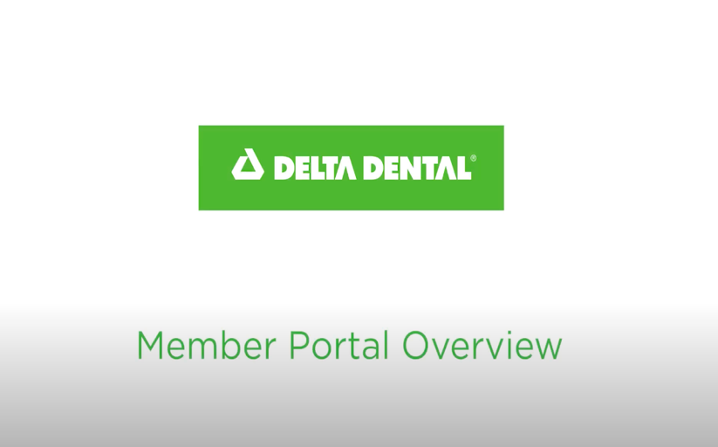

Delta Dental Member Portal
The easiest way to access your benefit information
Notes:
Using our portal is simple and it’s the easiest way to gain access to your benefit information, claims, and more!
Click on image in Slideshow to play video

Slide 29
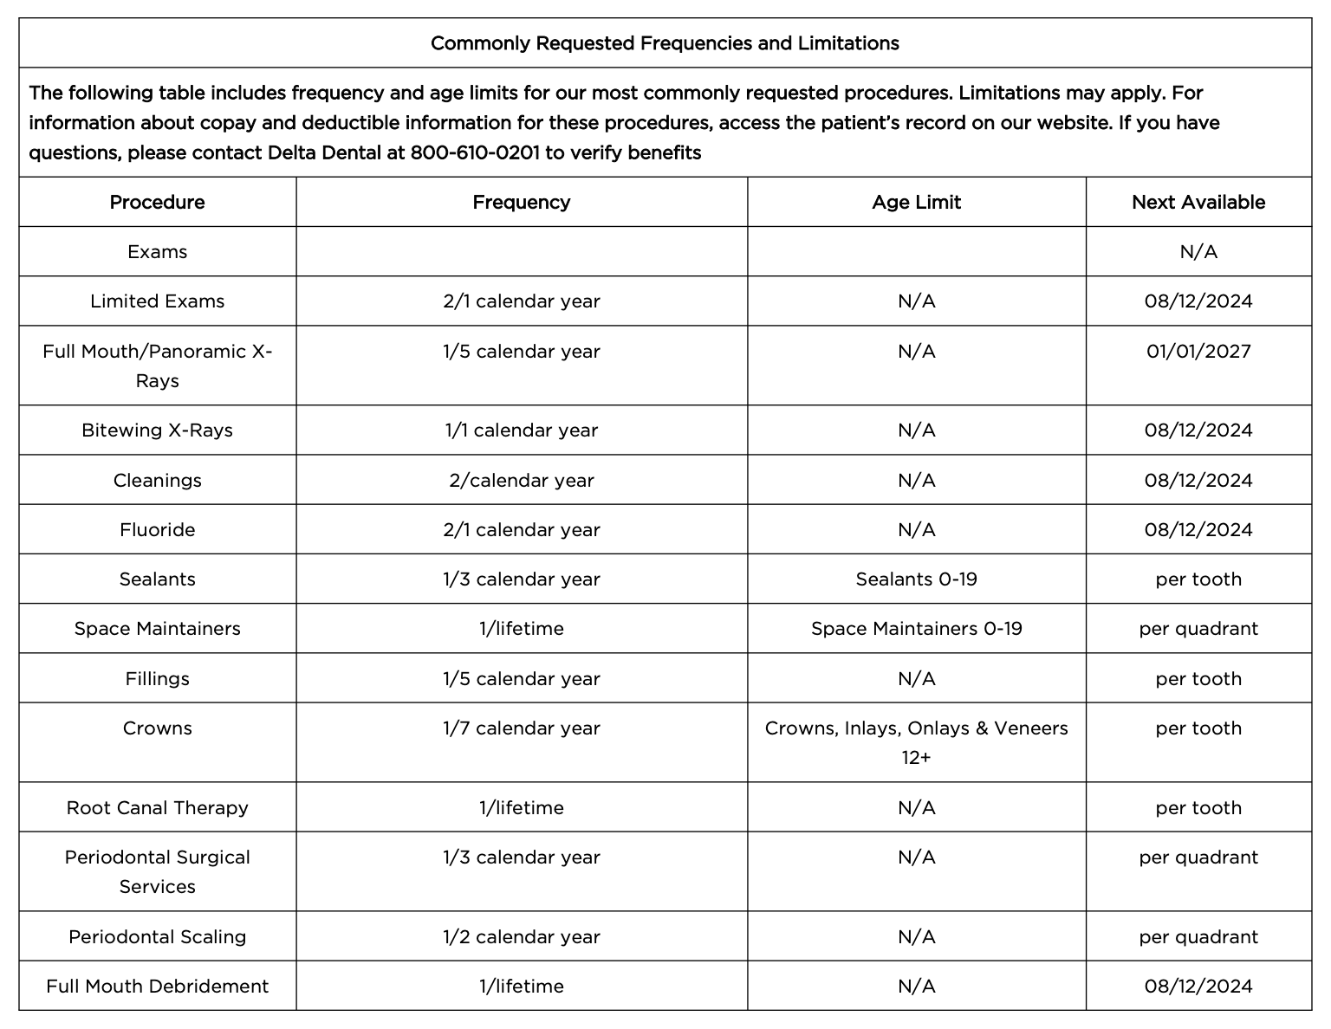
Benefit report
Quick access to a full report of your benefits
Notes:
Once you are logged in, you can download a full benefits report. This report provides a high-level overview of your coverage as well as the frequencies and age limitations for common services. This is a great report to bring with you when you go to the dentist, so you know if you are eligible for any recommended services.

Slide 30
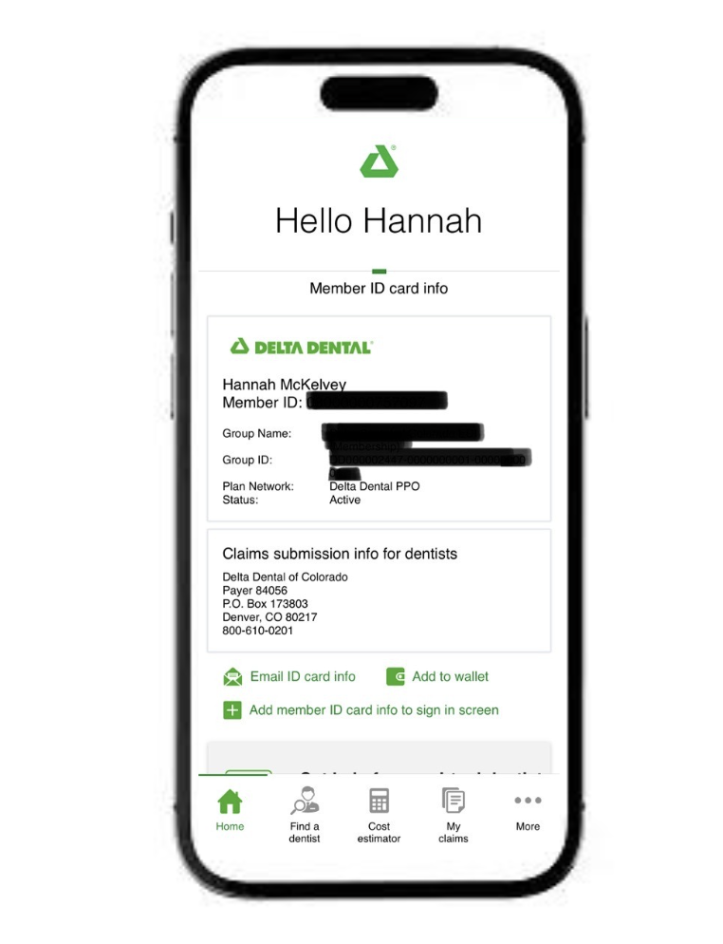

Mobile app
Create a subscriber account and access your benefits anywhere, anytime
Find a dentist
View benefits and claims
Mobile ID card – email to provider and dependents
Dental Care Cost Estimator
24/7 Virtual Dentist
Notes:
We all want access to information while we are on-the-go. Once you download the mobile app, you will have the ability to easily locate a dentist, view your ID card or claims, and much more.

Slide 31
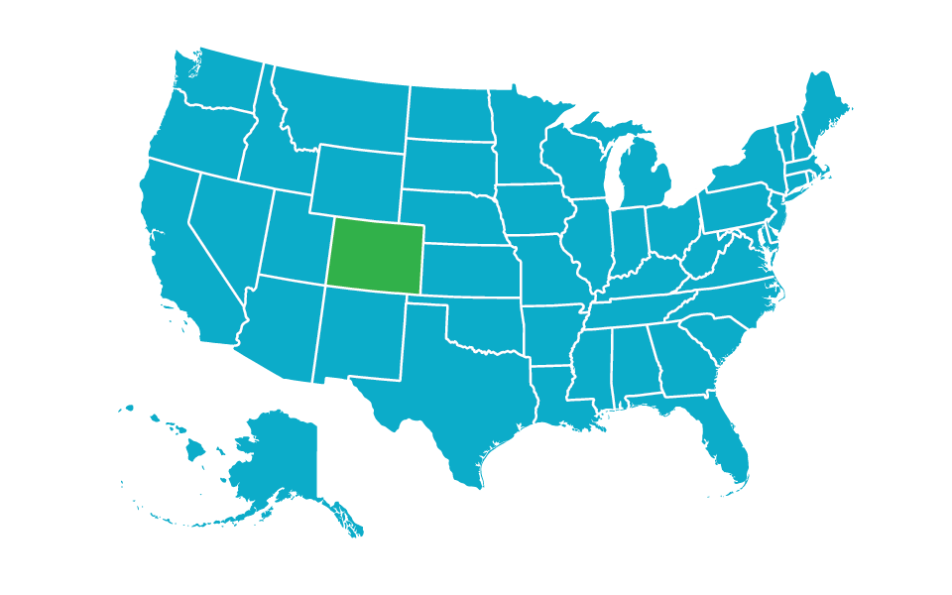
Local service
Service you need when you need it…because we live where you live
24/7 Automated Call Center
Phone:
1-800-610-0201
Email:
customer_experience@ddpco.com
Hours:
Monday – Thursday
7:30 am – 5 pm MT
Friday
9 am – 5 pm MT
Notes:
We are located right here in Colorado – in the Denver Tech Center actually. Our customer service team is trained and ready to assist you with additional questions you have. You can reach them by phone Monday-Friday from 7:30 a.m. to 5 p.m. or by email as indicated.

Slide 32

Let your
Mile High Smile PowerTM
shine!

